Slide 1
Digital Signal Processing Presentation

Slide 2
Group Members
Muhammad Burhan Ahmed - 210287
Muhammad Tahir Farooq- 190523
Jawaad Ali - 190523

Slide 3
Table of contents
01
02
03
Introduction
Background and Problem Statement
Methodology
04
05
06
Results
Applications
Conclusion

Slide 4
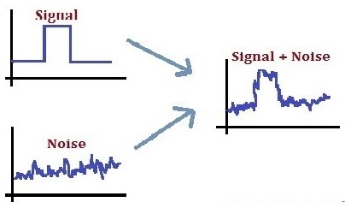
Introduction
Signals are representations of information and can be in various forms such as electrical voltages, sound waves, images, and more.
Signal processing deals with the
extraction, analysis, and
manipulation of signals and
time-series data.
Removing noise improves the
clarity and quality of the signal,
making it easier to interpret and
analyze.

Slide 5
Problem Statement
To develop a signal processing system that effectively detects the glitch and removes glitch as well as noise from the signal.

Slide 6
Procedure
Load the waveform.
Obtain the frequency spectrum.
Glitch detection using a short-time Fourier transform.
Remove glitch using lowpass filter.
Remove the noise using lowpass filter.

Slide 7
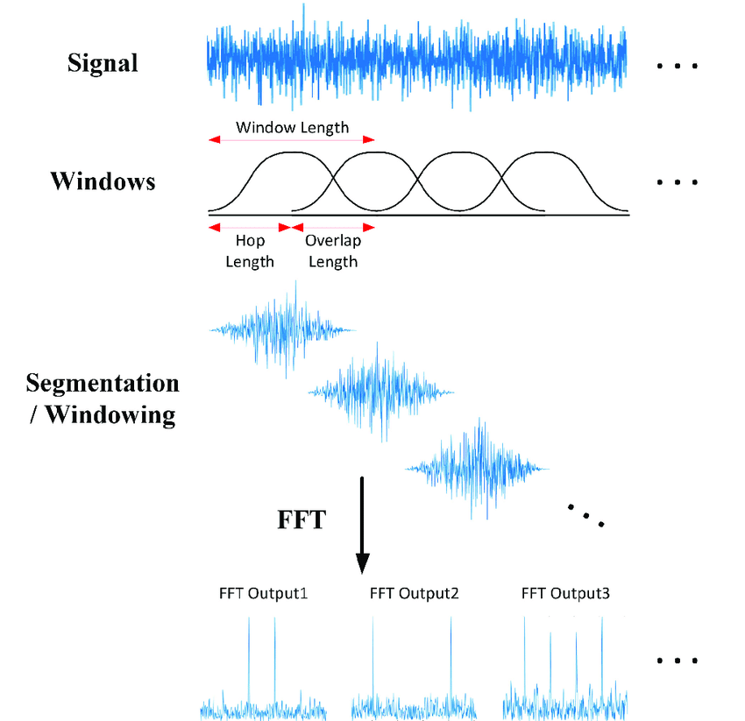
Methodology
STFT of the audio signal using the spectrogram function.
Short segments using a window-size and calculates the FFT of each segment.
Looks for sudden changes and irregularities

Slide 8
Short term fourier transform
STFT breaks down audio into small segments and analyzes how their frequency content changes over time.
STFT divides the audio into smaller chunks that overlap slightly, using window functions to ensure smooth transitions between them for analysis.
It apply FFT to each windowed segment to transform it from time to frequency domain, revealing frequency content.
Looks for sudden changes in the frequency domain, indicating glitches like spikes or irregularities.
Once a glitch is detected, use time information associated with each segment to pinpoint when the glitch occurred in the original audio signal.

Slide 9
CONTINUED
Removes the glitch from the sinusoidal waveform
Now, this glitch is removed using low pass filter.
Removes the noise from the sinusoidal waveform
the Noise from the signal is removed by using a low-pass filter. It returns a smooth sin wave.

Slide 10
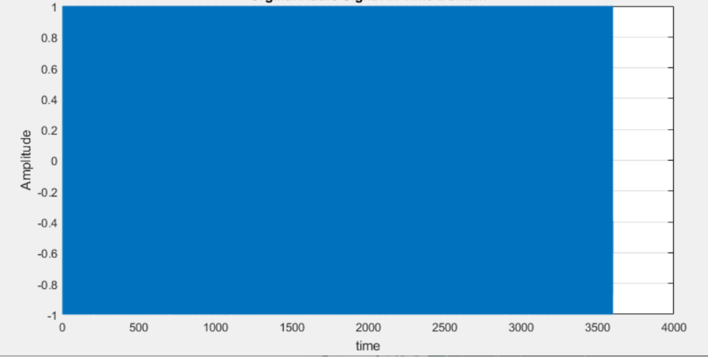
Original Audio signal in time domain

Slide 11
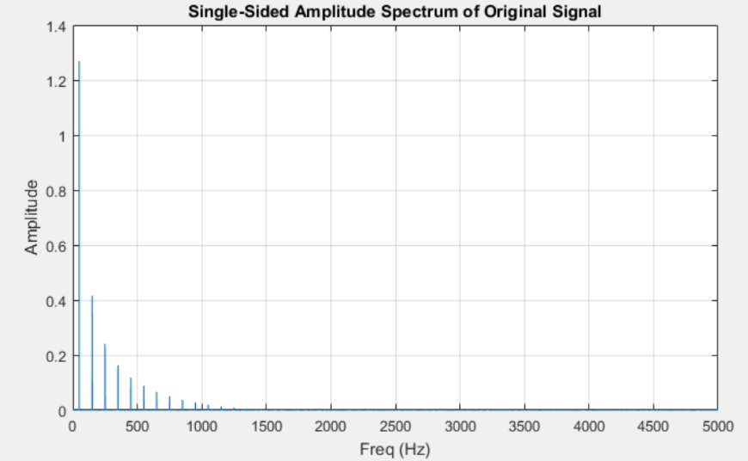
Single sided amplitude spectrum of original signal

Slide 12
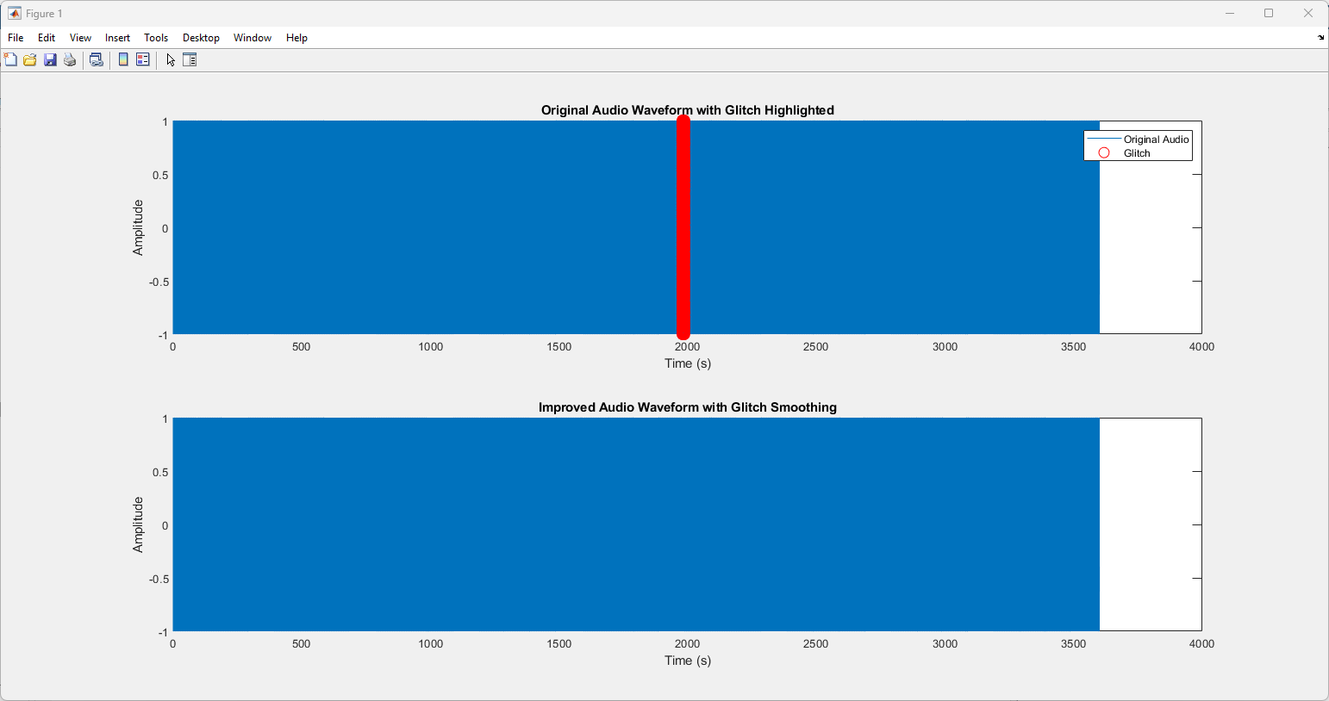
Results of Glitch Removal

Slide 13
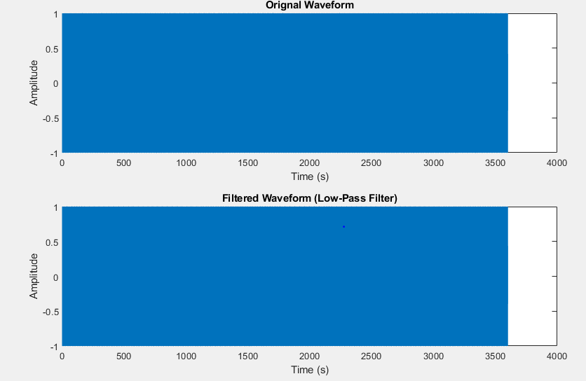
Results of Noise Removal

Slide 14
Applications
Audio Processing
Biomedical Engineering
Communication System
Industrial Automation

Slide 15
Conclusion
We used signal processing methods to enhance signal quality by reducing noise and removing glitches.
Through lowpass filtering and STFT we effectively attenuated high-frequency noise and remove glitch.
We developed algorithm for glitch identification, important for identifying disturbances within the signal.
Used Lowpass filters to remove noise to make signal noise free.

Slide 16
Thank You

